Slide 1

Image Comparison Using Needleman Wunsch Algorithm
Course Instructor
Mr. Vishwas H. N.
Team 13
Kanisettypalli Harshitha
Kavya Duvvuri
Kunisetty Jaswanth

Slide 2
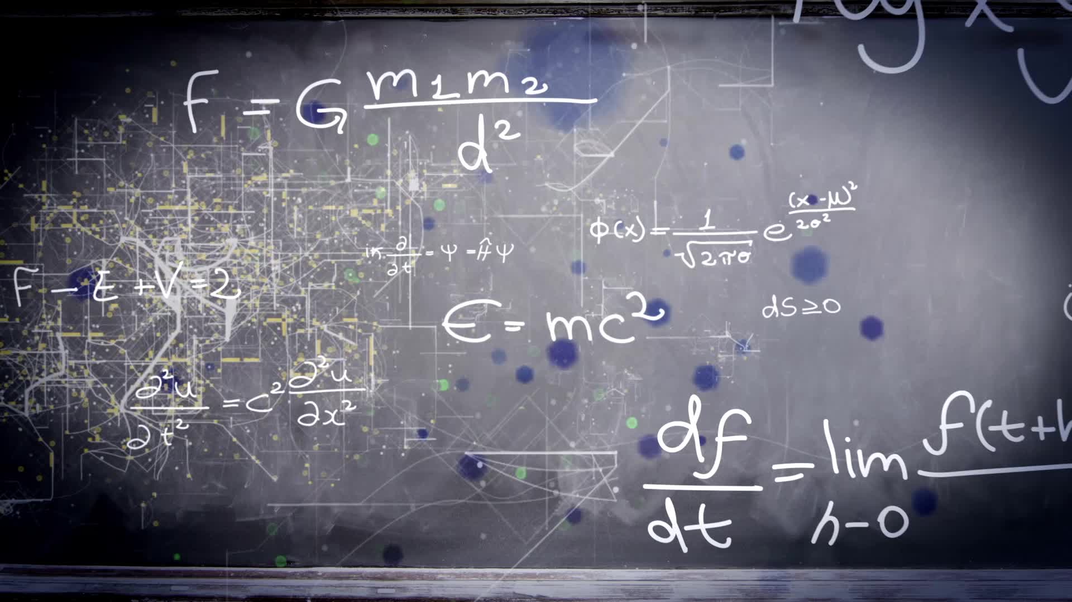
Contents
Sequence Alignment
Global Alignment
Needleman Wunsch Algorithm
Methodology
Applications of Needleman Wunsch Algorithm
Demonstration

Slide 3
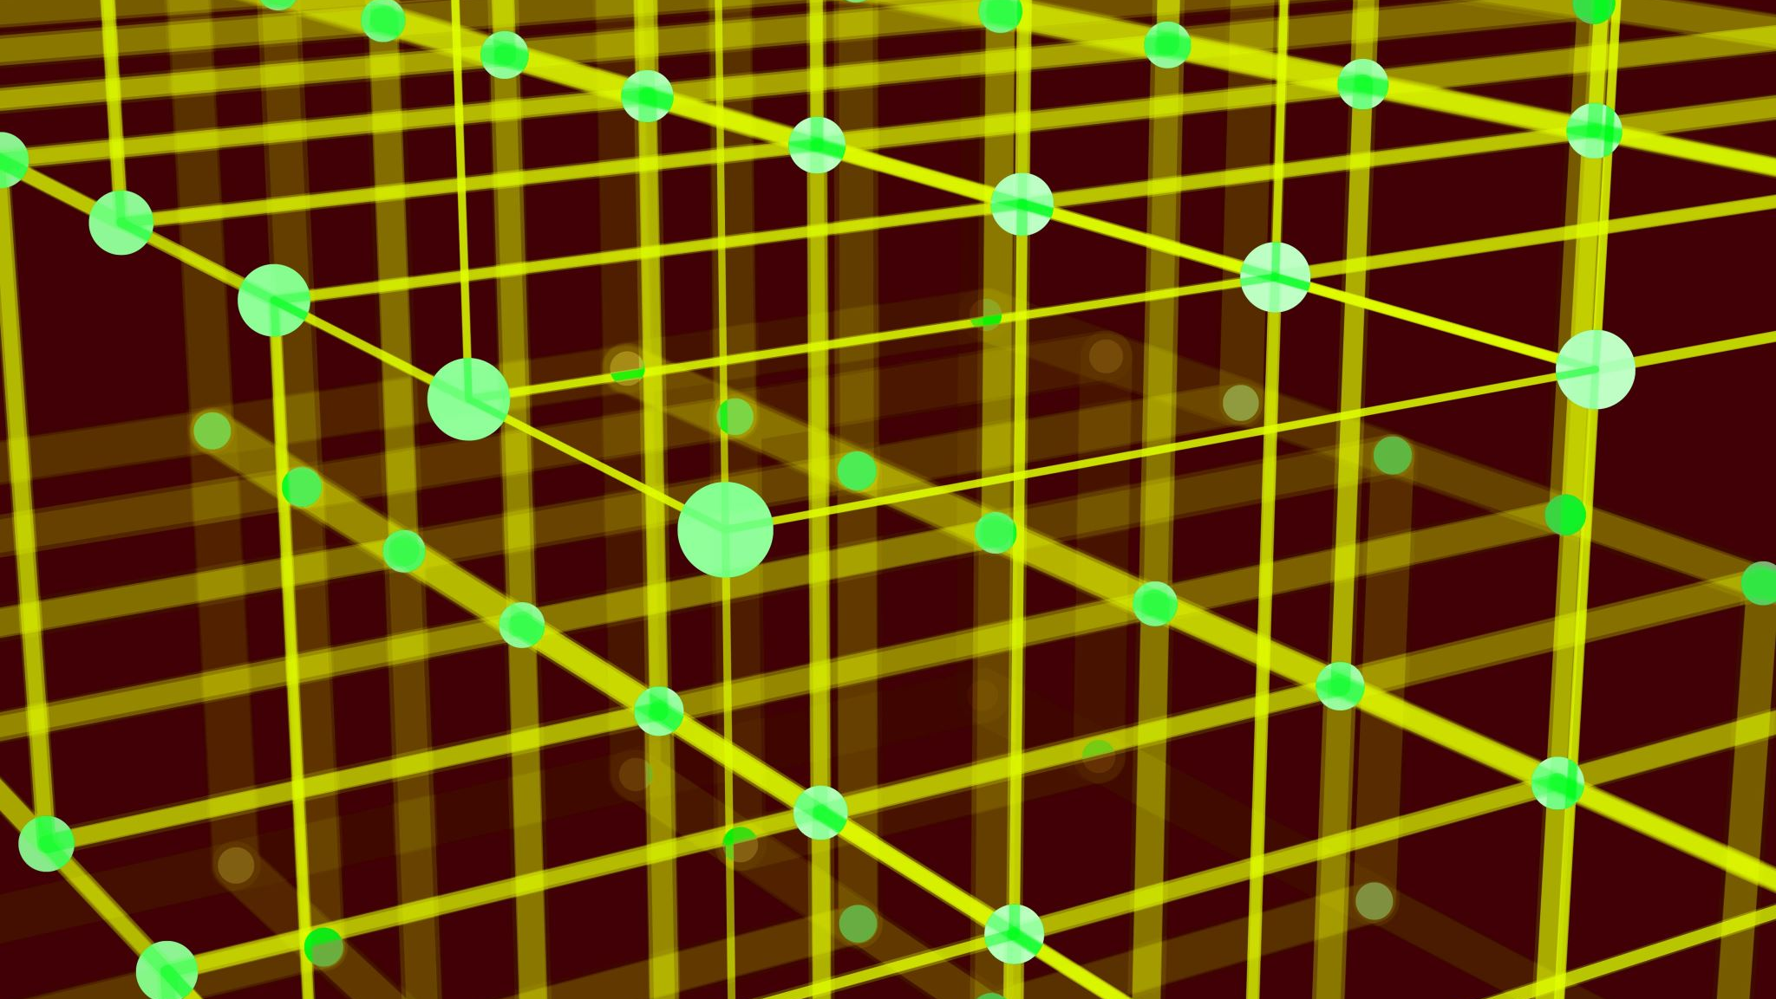
Sequence Alignment

Slide 4

A way of arranging DNA, RNA, or protein sequences to identify regions of similarity
The two sequences that are aligned are termed reference and query sequences.
Global Alignment
End-to-end alignment of two strings
Local Alignment
Matching a smaller sequence with respect to a larger sequence

Slide 5

Global Alignment
Gives better output when subject and query sequences have almost the same length
Alignment is carried out from start to end of sequences
Needleman-Wunsch algorithm is widely used for global alignment
It uses a dynamic programming approach

Slide 6

Needleman-Wunsch Algorithm
One of the first applications of dynamic programming used in biological sequencing
Developed by Saul Needleman and Christian Wunsch in 1970
It has a quadratic time complexity of O(n*m) where n and m are the lengths of input sequences
Follows 3 main steps for sequence alignment
Matrix Declaration
Matrix Filling
Traceback

Slide 7


Matrix Declaration
Lengths of input sequences
Reference: $n$
Query: $m$
Scores
Match Score: $1$
Mismatch Score: $−1$
Gap Score: $−2$
Create an empty matrix of dimensions $(n+1)×(m+1)$
Traverse across the first row and column by adding the gap scores in every move.

Slide 8
Matrix Initialization
D |  | A | T | C | G
 | 0 | -2 | -4 | -6 | -8
A | -2
T | -4
G | -6
C | -8
T | -10
Query Sequence | ATCG
Reference Sequence | ATGCT
Match Score | 1
Mismatch Score | -1
Gap Score | -2

Slide 9
Matrix Filling
D |  | A | T | C | G
 | 0 | -2 | -4 | -6 | -8
A | -2
T | -4
G | -6
C | -8
T | -10
Diagonal Movement
Check the letters and add either match or mismatch scores.
Vertical and Horizontal Movement
Add gap score
After noting down these values fill the maximum of those values into the matrix.
A
0 | -2
-2 | 1
A
Value from top = -4
Value from left = -4
Value from diagonal = 1
Maximum = 1

Slide 10
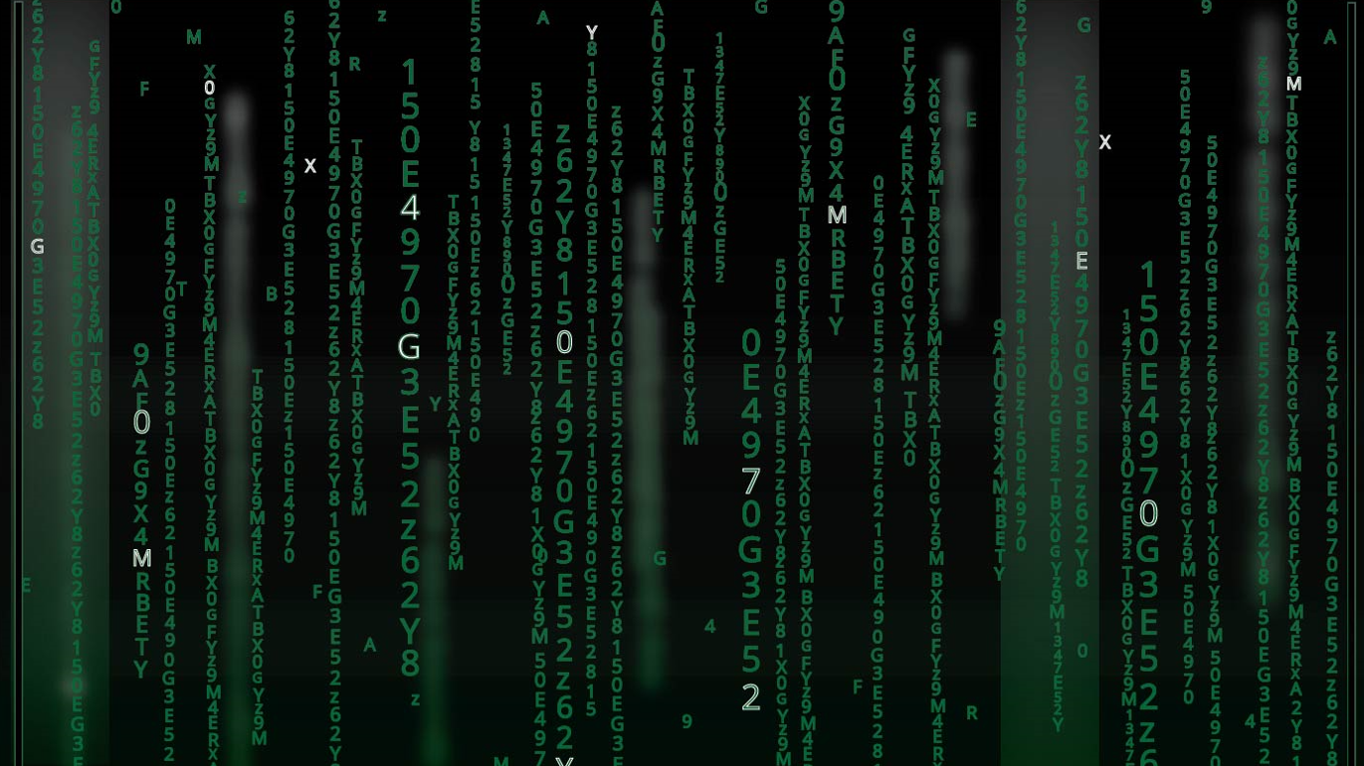
Traceback
Start from the last element of the matrix
Check if nucleotides are equal
If yes, move diagonally up
If no, move to the cell that has a maximum element in the surrounding
Append a ‘-’ to the resulting string if movement is not along diagonal
Append a ‘*’ to the resulting string if movement is along diagonal with a greater value holding cell
Append the nucleotide value if the movement is to a lesser value along the diagonal.

Slide 11
Final Matrix and Traceback
D |  | A | T | C | G
 | 0 | -2 | -4 | -6 | -8
A | -2 | 1 | -1 | -3 | -5
T | -4 | -1 | 2 | 0 | -2
G | -6 | -3 | 0 | 1 | 1
C | -8 | -5 | -2 | 1 | 0
T | -10 | -7 | 4 | -1 | 0
ATGCT
|
|
|
*
AT_CG

Slide 12
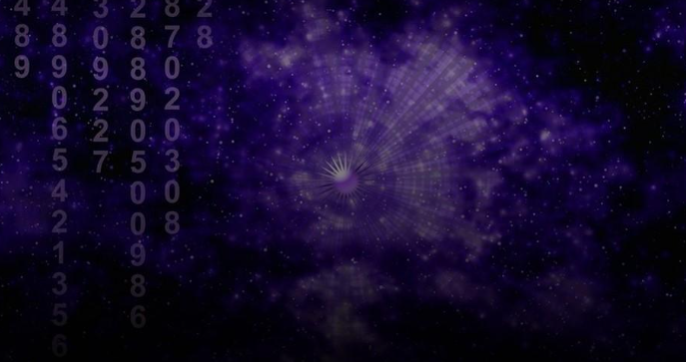
Applications of Needleman Wunsch
Aligning biological sequences like DNA, RNA, and Proteins
Finding mutations in DNA or RNA
We have brought out a new application of the Needleman Wunsch algorithm.
Image Comparison

Slide 13
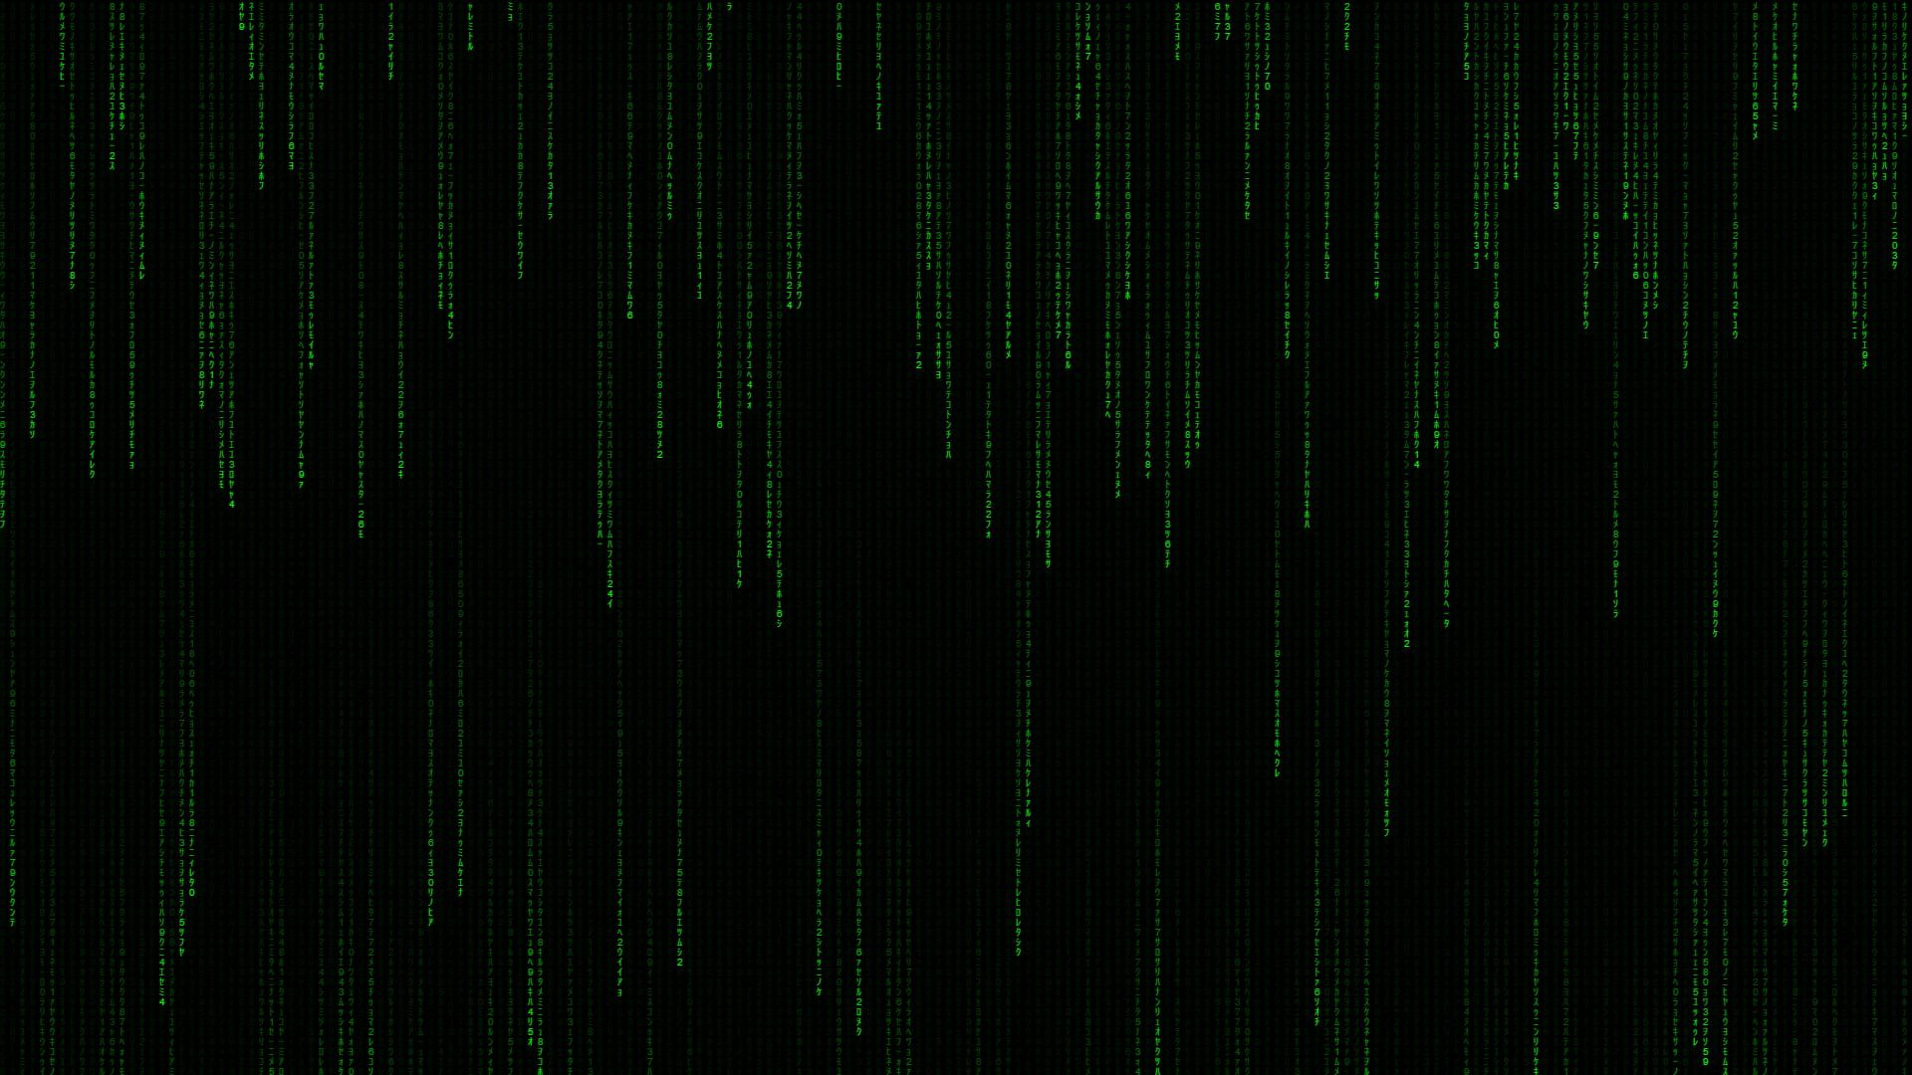
Face Recognition
Distorted face is considered as query image to the algorithm
The query image is resized and flattened
A dataset contains a set of reference images which are also resized and flattened.
The flattened query image is aligned with the flattened vectors of all the reference images.
The image with the best score is identified and given as output.

Slide 14
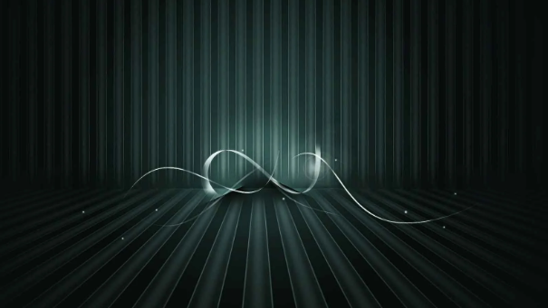
Traffic Light Color Detection
The query image is a closely cropped traffic light
This image is resized and flattened
The flattened vector is compared to the resized and flattened vector of reference-colored images.
The color that gives maximum score is recognized to be the color in the query image.

Slide 15
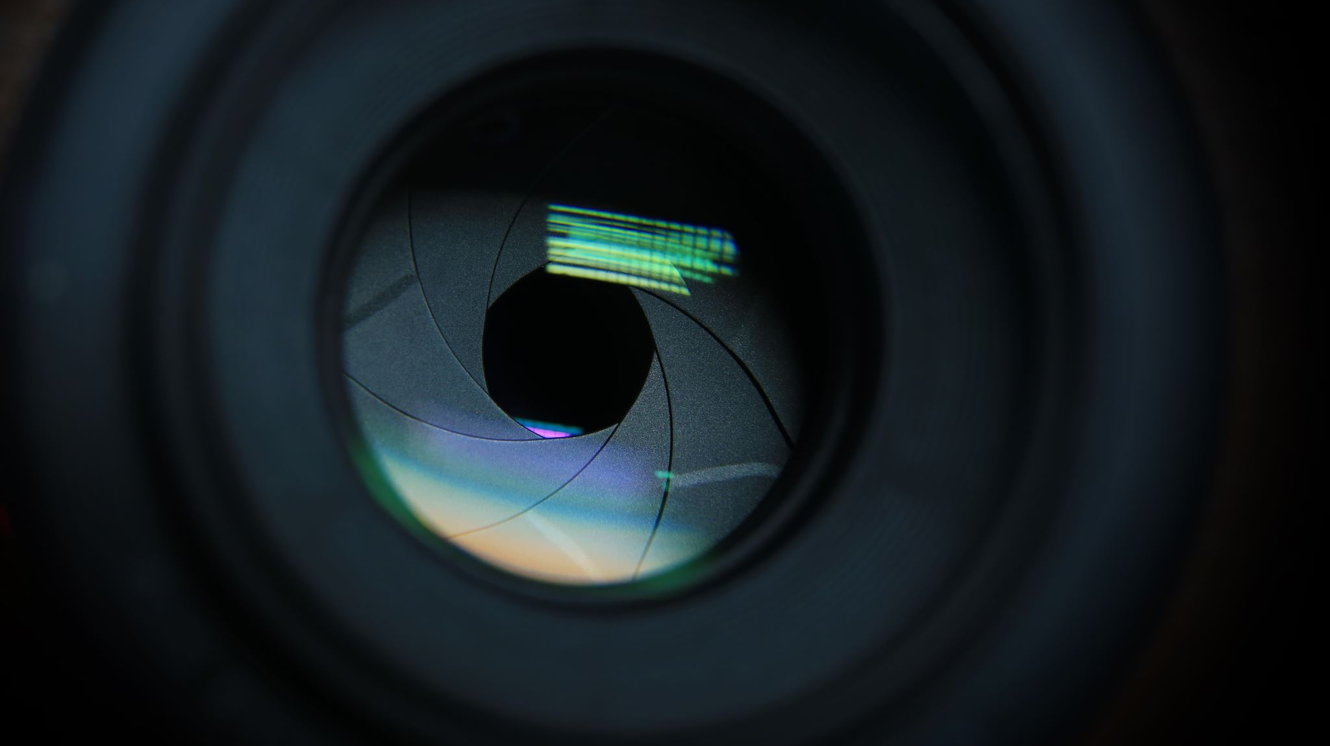
Demonstration

Slide 16


